Slide 1
Update on “Team working in Clinical Imaging ” 11th October 2018
Richard Evans
Chief Executive Officer
The Society of Radiographers
Notes:
Thanks etc
Apologies for not being Charlotte
…or the Policy Director

Slide 2
Team Working in Healthcare
Evidence consistently shows that multi-professional team working delivers better outcomes for patients and more effective and satisfying clinicians
Multi-professional work requires flexibility in attitude and behaviour and for professionals to value and respect the distinct contribution each professional makes
Notes:
Realisation that work in healthcare depends on team working.
Academy of Medical Royal Colleges appropriately leading to lay to rest the idea that there is only one profession that matters in healthcare

Slide 3
Team Working in Healthcare
New ways of working and delivering healthcare requires employers to ensure that clinicians have the professional development they need to adapt to changing circumstances
New solutions are required to deliver healthcare to meet the changing needs of the population. This will need new ways of working, new roles and new behaviours.

Slide 4
Team Working Update
Joint document “cements the Colleges' shared views on what constitutes effective team working”
Provides guidance on the five key areas of:
Justification of examination requests
Radiation protection
Image acquisition
Reporting
Management and service improvement
RCR and SCoR 2012, currently under review
Notes:
This is rather older than the AoMRC work.
Broad scope
Landmark at the time
NB Currently under review…

Slide 5
Team Working Update
Review initiated by the Colleges
Summer 2017
Take account of the current context
Retain & build upon the principles defined in 2012 guidance
Embed ISAS – quality service: patient at the heart
All aspects of team working – not solely reporting

Slide 6
Team Working Update
Introduction
- Quality: Imaging Services Accreditation Scheme (ISAS)
Leading a team and team culture
Working collaboratively
Learning together
Resolving Issues
- including raising concerns
Goal : Shorter, succinct document
Completion early 2019
Patient-centred team working in clinical imaging
Notes:
Referencing joint colleges approach to quality improvement and specifically to the standard that is used for accreditation in ISAS.
Collaborative best practice document
Positive message on good team working to respond to service pressures

Slide 7
Team Working Update
…Oh, and no reporting
Notes:
The first team working document specifically and ground-breakingly referenced reporting
The revised version will refer to a parallel piece of work

Slide 8
Reporting Standards Steering Group
Establishing joint standards for image reporting
SCoR and RCR
Chaired by HEE
Starting with MSk Imaging
Aiming for agreed learning outcomes for all
Notes:
MSK first but intending to move on to ultrasound and Breast imaging (at least)
Based on standardising learning outcomes for all training programmes.
HEIs have provided curricula
Standards intended to be the same for all professions reporting.
Bev Snaith and Keith Piper.

Slide 9
Reporting Standards Steering Group
Establishing joint standards for image reporting
Chaired by HEE
300 additional reporting radiographers
Investment over two years
Notes:
Team working suddenly has sponsorship!
Standards will be UK-wide
HEE support England only 150 this year. 150 next
Programme in Scotland looking at utilising existing capacity but bound to be pressure to train more reporting

Slide 10
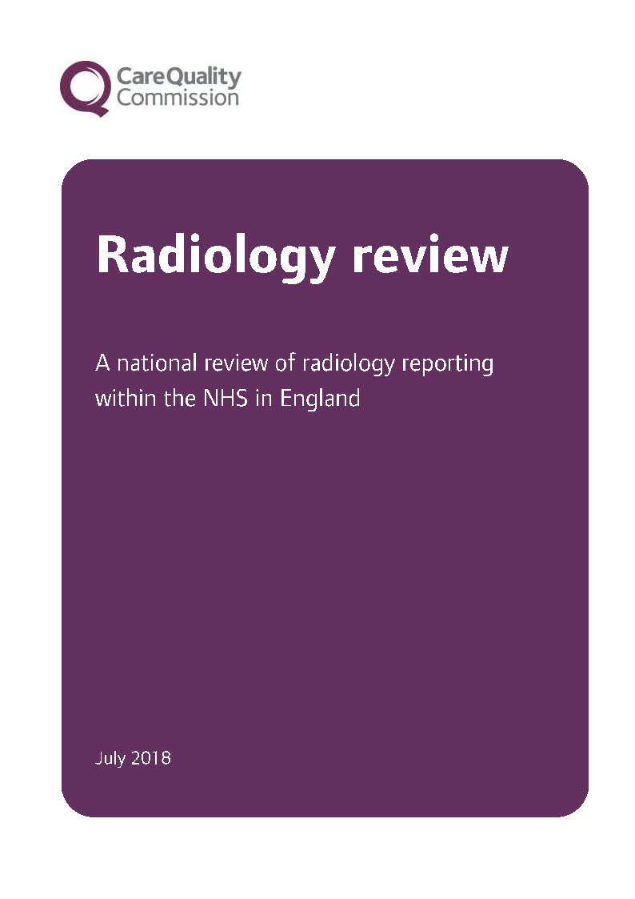
Team Working in Imaging Services
CQC Report
Notes:
Another challenge for team working, specifically around reporting

Slide 11
Team Working in Imaging Services
CQC Report
“The Royal College of Radiologists and the Society and College of Radiographers should make sure that clear frameworks are developed to support trusts in managing turnaround times safely.”
Recommendations
NHS trust boards should ensure that:
they have effective oversight of radiology backlogs
risks to patients are fully assessed and managed
staffing and other resources are used effectively to ensure examinations are reported in an appropriate timeframe.
The NHS Improvement National Imaging Optimisation Delivery Board should establish national standards for report turnaround times as a matter of urgency, so that trusts can monitor and benchmark their performance.
The Royal College of Radiologists and the Society and College of Radiographers should make sure that clear frameworks are developed to support trusts in managing turnaround times safely.
Notes:
CQC recognition that colleges work in partnership and will need to do so to sort out the problems of backlogs
Statement of intent coming
Relationship to Quality Improvement and management
New approaches being planned

Slide 12
In other news: ACP
Advanced Clinical Practice
“high degree of autonomy and complex
decision making.”
“clinical practice, leadership / management,
education and research”
“master’s level award or equivalent”
Notes:
This is to update this particular audience on other current work

Slide 13
In other news: ACP
“Advanced clinical practice embodies the
ability to manage clinical care in partnership
with individuals, families and carers.
It includes the analysis and synthesis of complex
problems across a range of settings,
enabling innovative solutions to enhance
people’s experience and improve outcomes.”
www.hee.nhs.uk/our-work/advanced-clinical-practice

Slide 14
In other news: ACP
Harmonisation of advanced levels of practice across the professions is important in enabling wider and efficient roll out of advanced clinical practice to continually support improvements in patient care

