Slide 1
Team working
Charlotte Beardmore
Director of Professional Policy
29 Jan 2018
charlotteb@sor.org
@SCoRCBeardmore

Slide 2

Settings ………..
Population based planning
  Hospitals / Regions Cancer Alliances/ partnerships
https://www.england.nhs.uk/wp-content/uploads/2018/01/acute-care-collaboration-learning.pdf
Notes:
Standardising clinical practice: providing consistently high-quality care by pooling expertise, sharing data and analysing patient care across hospitals
2) Optimising clinical support services: standardising, coordinating and consolidating clinical support services, such as imaging and pathology, to improve patient flow and efficiency
3) Optimising corporate support services: standardising or consolidating corporate functions and exercising collective purchasing power to save money
4) Making the best use of workforce and developing talent: developing creative and flexible workforce approaches to reduce reliance on agency staff, improving continuity of care for patients, and generating new career opportunities to help attract and retain the best staff
5) Building innovative external partnerships: attracting investment and co-producing innovative solutions to clinical and management challenges
6) Supporting integrated health systems: championing person-centred, integrated approaches through better co-ordinated primary and community health and care, and by investing in prevention
There are three broad types of acute care collaborations: single-service, multi-service and hospital group. These models can use different types of organisational integration, broadly grouped into collaborative, contractual and consolidated models, building on the work o

Slide 3


Joint team-working document review
Working party established
Goal: publication autumn 2018
Objectives:
Take account of the current context
Retain & build upon the principles defined in 2012 guidance
Embed ISAS – quality service - patient at the heart
All aspects of team working – not solely reporting
Working party comprises
RCR-Dr Andy Smethurst
RCR-Dr Jonathan Hopkins
SCoR -Penny Owens
SCoR -Charlotte Beardmore
Project Manager – Fionnuala Morrisey & Senior Manager - Tania Vanburen
1st meeting August 2017 followed by a mix of face to face and telephone conference calls - focusing on specific sections – approximately 7 meetings to date.

Slide 4



HEE led work
1st meeting December 2017
2nd meeting January 2018
Explore opportunities for the development of national reporting standards & assessment
Funding to support a programme of work
Health Education England (HEE) commitment
Investment in 300 + reporting radiographers – announced Dec 2017 & in the system by 2021

Slide 5

UKRCO 2018
Evolution or Revolution: The radiology reporting workforce
Developing an integrated reporting team, a decade’s experience
Speakers Bev Snaith and Dr Nick Spencer
Shaping Standards for the future reporting team
Speakers Charlotte Beardmore and Dr Andrew Smethurst

Slide 6


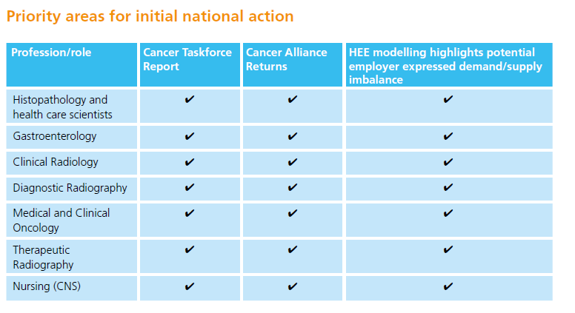
Context – workforce priorities
Making the most of what is available
Medium (1-3 yr) to long term planning
Ensuing local and national alignment
Future need
Investment in 300 + reporting radiographers
https://www.hee.nhs.uk/our-work/planning-commissioning/workforce-strategy/cancer-workforce-plan
Notes:
The introduction of the report states ‘ It is the people working in our NHS – the GPs nurses, oncologists, radiographers and radiologists to name but a few who will deliver these improvements - 2 phases- short term ie to 2021 and then a longer term strategy which is calling for evidence.

Slide 7
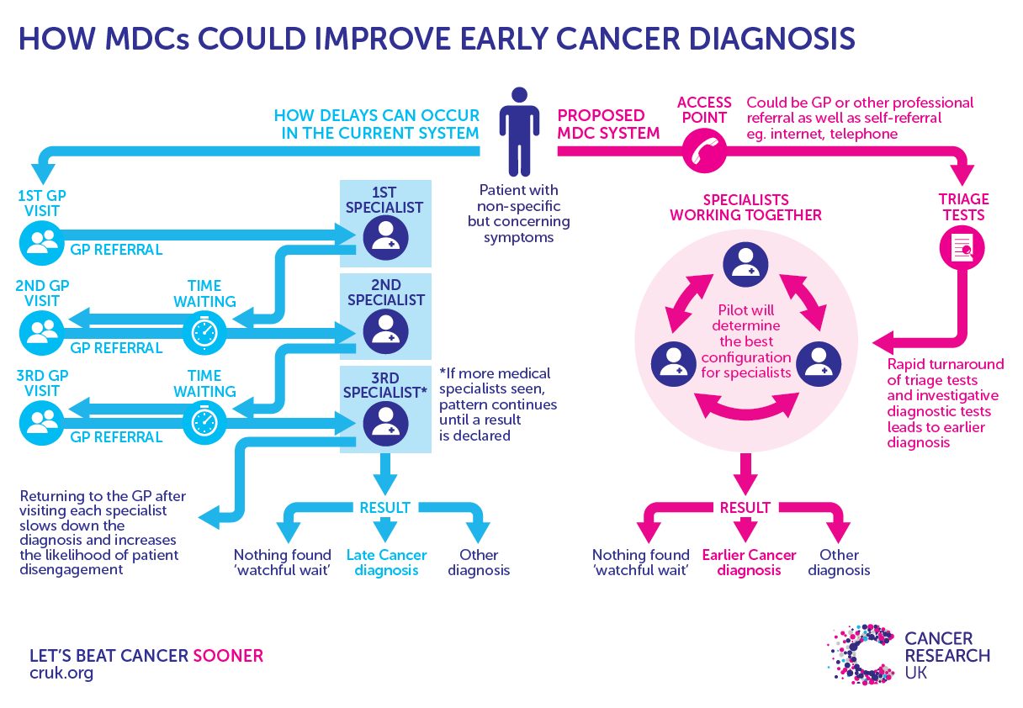
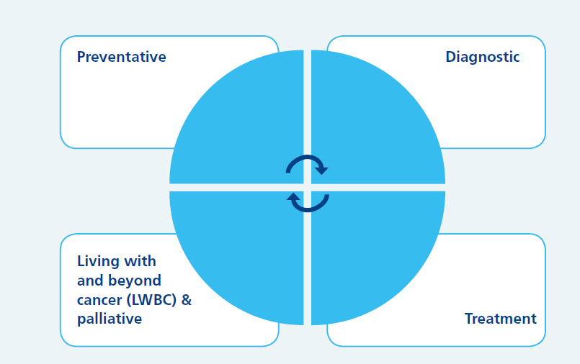
New service models essential……..
https://www.hee.nhs.uk/our-work/planning-commissioning/workforce-strategy/cancer-workforce-plan
http://www.cancerresearchuk.org/health-professional/diagnosis/ace-programme/ace-findings-and-resources
Notes:
The Multidisciplinary Diagnostic Centre (MDC) concept comes from Denmark where a patient can undergo several diagnostic tests in one location, at the same time, leading to a faster diagnosis. An MDC doesn’t have to be a new ‘centre’, but can be set up within an existing hospital or community setting and would supplement cancer specific diagnostic pathways.
MDCs can potentially be an effective way to support patients with non-specific symptoms who tend to present late, and support GPs whom are unsure of the appropriate referral pathway.

Slide 8


Evidence consistently shows that multi-professional team working delivers better outcomes for patients and more effective and satisfying clinicians
Multi-professional work requires flexibility in attitude and behaviour and for professionals to value and respect the distinct contribution each professional makes
New ways of working and delivering healthcare requires employers to ensure that clinicians have the professional development they need to adapt to changing circumstances
New solutions are required to deliver healthcare to meet the changing needs of the population. This will need new ways of working, new roles and new behaviours.
http://aomrc.org.uk/wp-content/uploads/2017/10/JOINT-PROFESSIONS-STATEMENT-111018.pdf

Slide 9
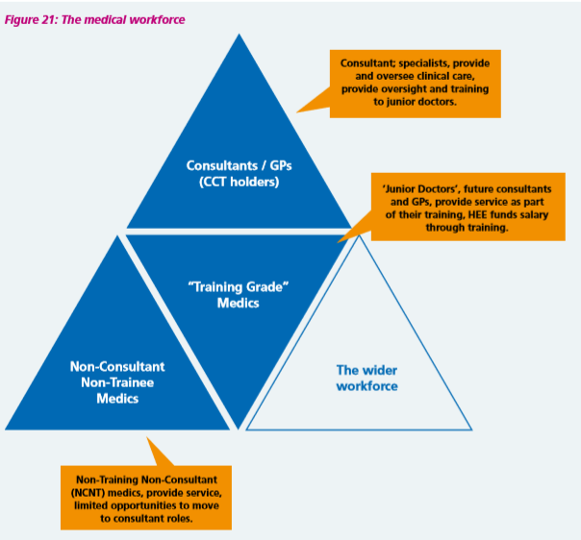
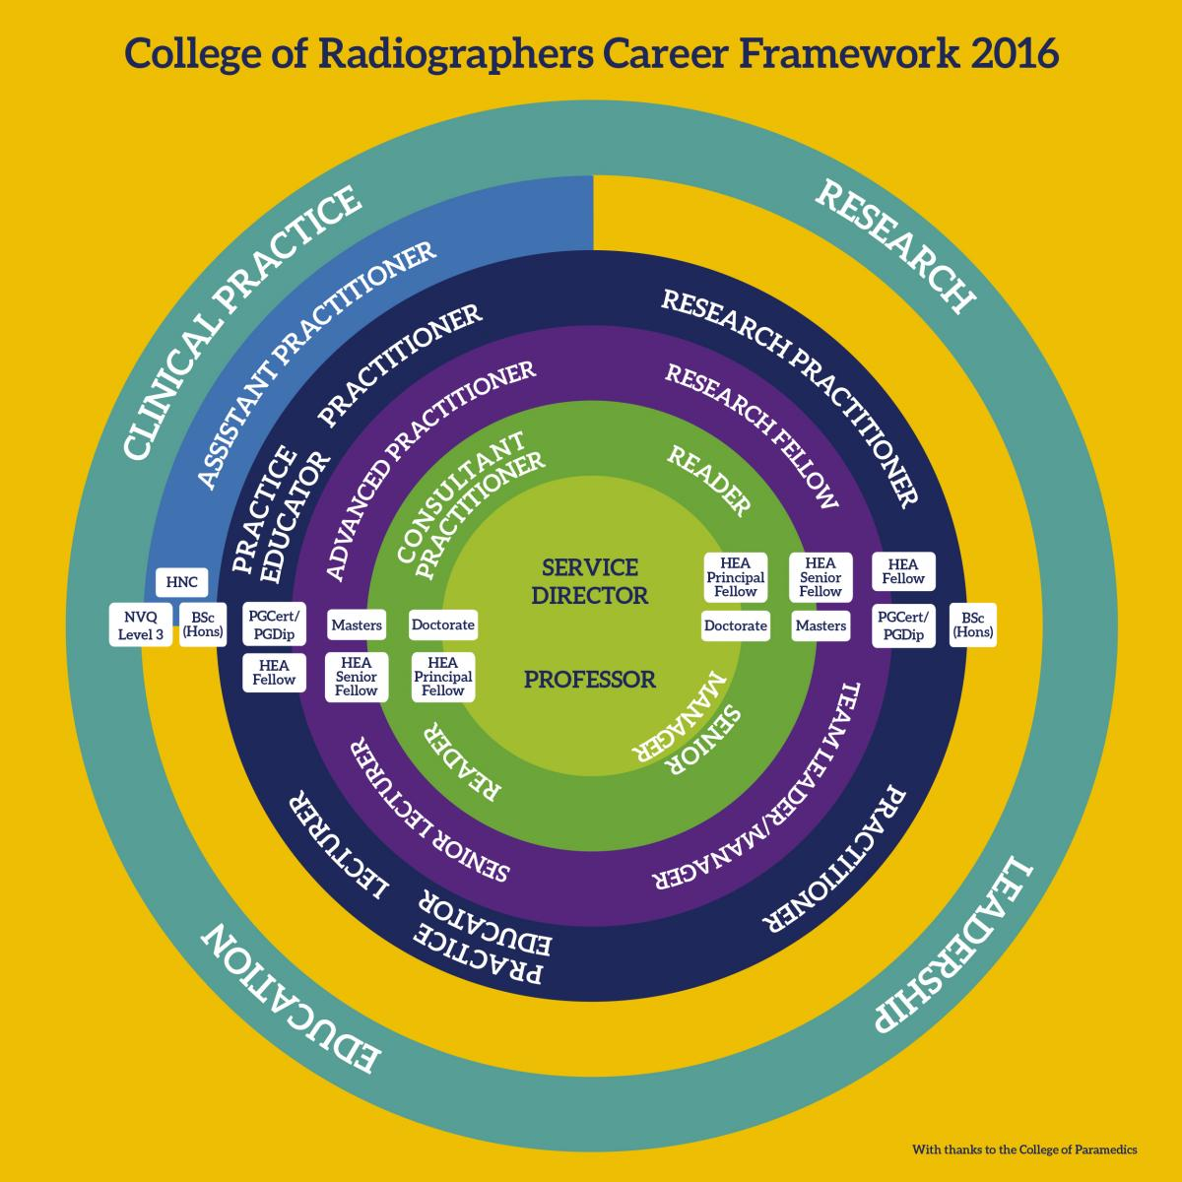
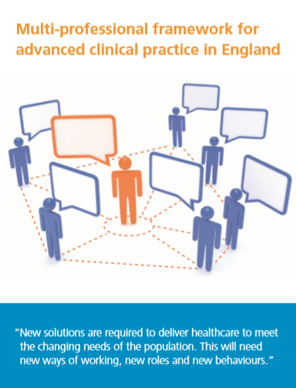

Opportunities
Context of medical and non-medical workforce –clinical decision making
Build capacity and capability within teams
    Team transformation
  CoR career framework
    Expert clinical practice
    Education
    Leadership
    Research
  HEE Advanced Clinical Practice
https://www.hee.nhs.uk/sites/default/files/documents/Facing%20the%20Facts%252c%20Shaping%20the%20Future%20%281%29.pdf

Slide 10

Whole service approach
Unite professional groups to support further development of efficient and productive teams- realise the full potential of all staff and meet the needs of the population served.
Example : eye health whole workforce approach
Royal College of Opthamologists, the College of Optometrists, the British and Irish Orthoptic Society and the Royal College of Nursing developed a common clinical competency framework in 2017
Framework for the contribution and future potential of the workforce to be better understood at 3 levels of practice from support worker to ACP and beyond.
https://www.rcophth.ac.uk/wp-content/uploads/2015/10/RCOphth-The-Way-Forward-Emergency-Eye-Care-300117.pdf

Slide 11
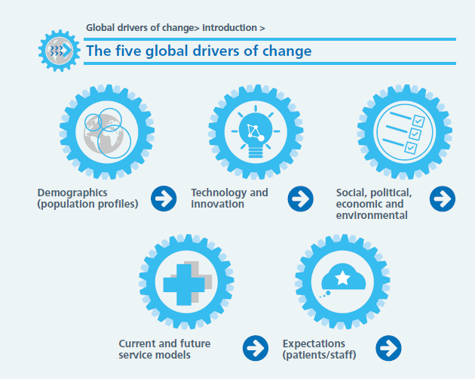
Shaping the future - ‘disruptive’
Major ‘Technology review’ 2018
Government appointment - Prof Eric Topol
  Impact of genomics, machine learning, artificial intelligence, digital technology and robotics – impact on skills and teams
  Recognise that models of care can be outdated with technological developments /pathway redesign – but that care and compassion must remain constant
  Education requirements
https://www.hee.nhs.uk/our-work/planning-commissioning/workforce-strategy/cancer-workforce-plan

Slide 12
Reflections
Understanding the collective skills across the team
Understand the population need for service / team – what matters?
Truly understand what each professional can/could do
What is it that only certain professions can do? Is this real?
How much flex do you have in who and what you have?
Foster trust, respect and understanding of roles
Move beyond developing on ‘trusted individual’
Ensure recognisable / mobile qualifications
Train each other, train together at appropriate levels
Positively impact on the learning environment
Ensure public safety and confidence Presented by HEE 23 Jan 2018

Slide 13

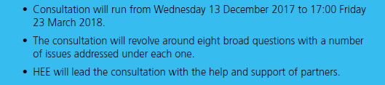
Workforce
Securing the supply of staff
Enabling a flexible and adaptable workforce
Widening participation / broad career pathways
Service development/ workforce plans/ financial impact/ restraints are integrated
‘Modern employers’
https://www.hee.nhs.uk/sites/default/files/documents/Facing%20the%20Facts%252c%20Shaping%20the%20Future%20%281%29.pdf

